Slide 1

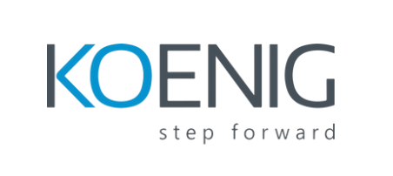
Building Eﬀective Docker
Images
Practical Tips for Fast, Small, and Secure Containers
Your Name
Processed by PPT Studio
Image Source: Programming code abstract technology background of software
Notes:
Could not generate speaker notes: 429 You exceeded your current quota, please check your plan and billing details. For more information on this error, head to: https://ai.google.dev/gemini-api/docs/rate-limits. [violations {
quota_metric: "generativelanguage.googleapis.com/generate_content_free_tier_requests"
quota_id: "GenerateRequestsPerDayPerProjectPerModel-FreeTier"
quota_dimensions {
key: "model"
value: "gemini-1.5-flash"
}
quota_dimensions {
key: "location"
value: "global"
}
quota_value: 50
}
, links {
description: "Learn more about Gemini API quotas"
url: "https://ai.google.dev/gemini-api/docs/rate-limits"
}
, retry_delay {
seconds: 15
}
]

Slide 2
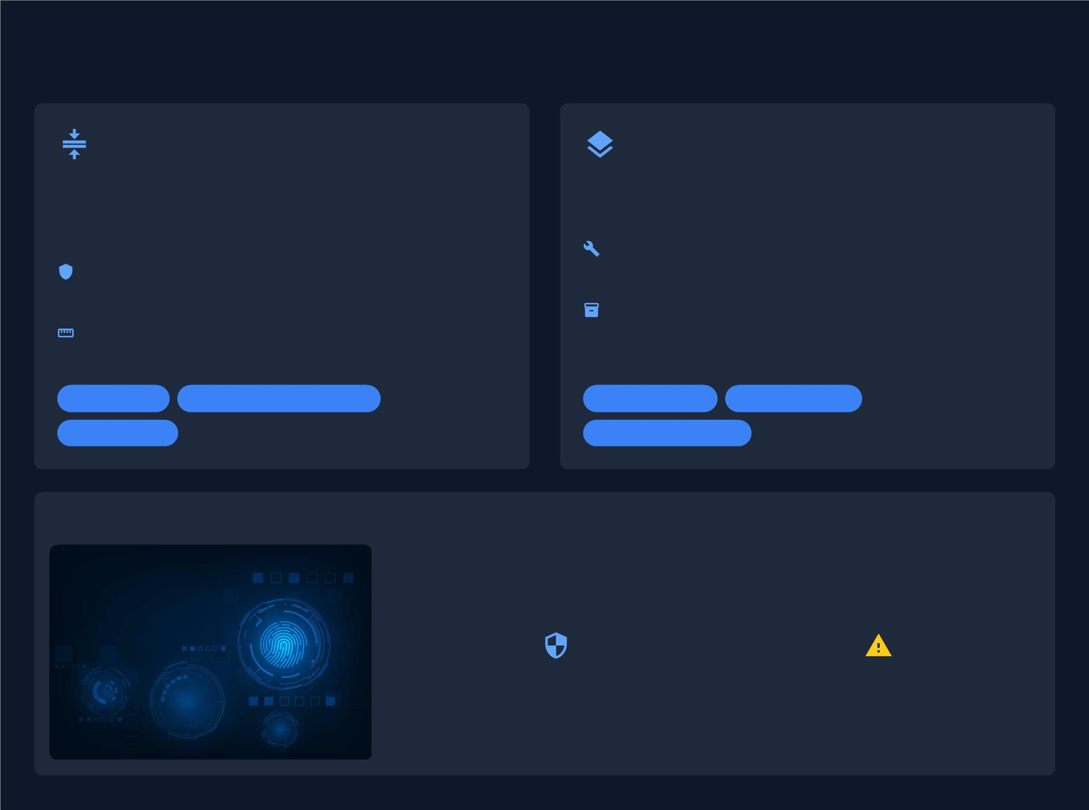
Foundational Optimizations
Minimal Base Images
Multi-Stage Builds
Start your Docker builds with the most lightweight base
image variants available, such as `alpine` or `debian-
slim`.
Separate the build environment from the ﬁnal runtime
environment within a single Dockerﬁle.
Builder Stage: Use a full-featured image with all tools
Reduced Attack Surface: Less software means fewer
needed to compile and build your application.
potential vulnerabilities. Bloated images increase risk.
Runtime Stage: Copy only the compiled artifacts into
Smaller Footprint: Drastically decreases image size
a clean, minimal base image for the ﬁnal product.
for faster pulls, reduced storage, and better caching.
Lightweight
Faster Builds
Reduced Attack Surface
Size Reduction
Cleaner Output
Optimized Artifacts
Tangible Beneﬁts & Security Posture
Dramatically improve both performance and security through these foundational
practices.
Processed by PPT Studio
44%
30+
of image scans reveal known vulnerabilities
vulnerabilities are found in many popular,
due to non-optimized base images.
unoptimized Docker images.
Source: Snyk - 10 Docker Security Best Practices
Notes:
Could not generate speaker notes: 429 You exceeded your current quota, please check your plan and billing details. For more information on this error, head to: https://ai.google.dev/gemini-api/docs/rate-limits. [violations {
quota_metric: "generativelanguage.googleapis.com/generate_content_free_tier_requests"
quota_id: "GenerateRequestsPerDayPerProjectPerModel-FreeTier"
quota_dimensions {
key: "model"
value: "gemini-1.5-flash"
}
quota_dimensions {
key: "location"
value: "global"
}
quota_value: 50
}
, links {
description: "Learn more about Gemini API quotas"
url: "https://ai.google.dev/gemini-api/docs/rate-limits"
}
, retry_delay {
seconds: 15
}
]

Slide 3
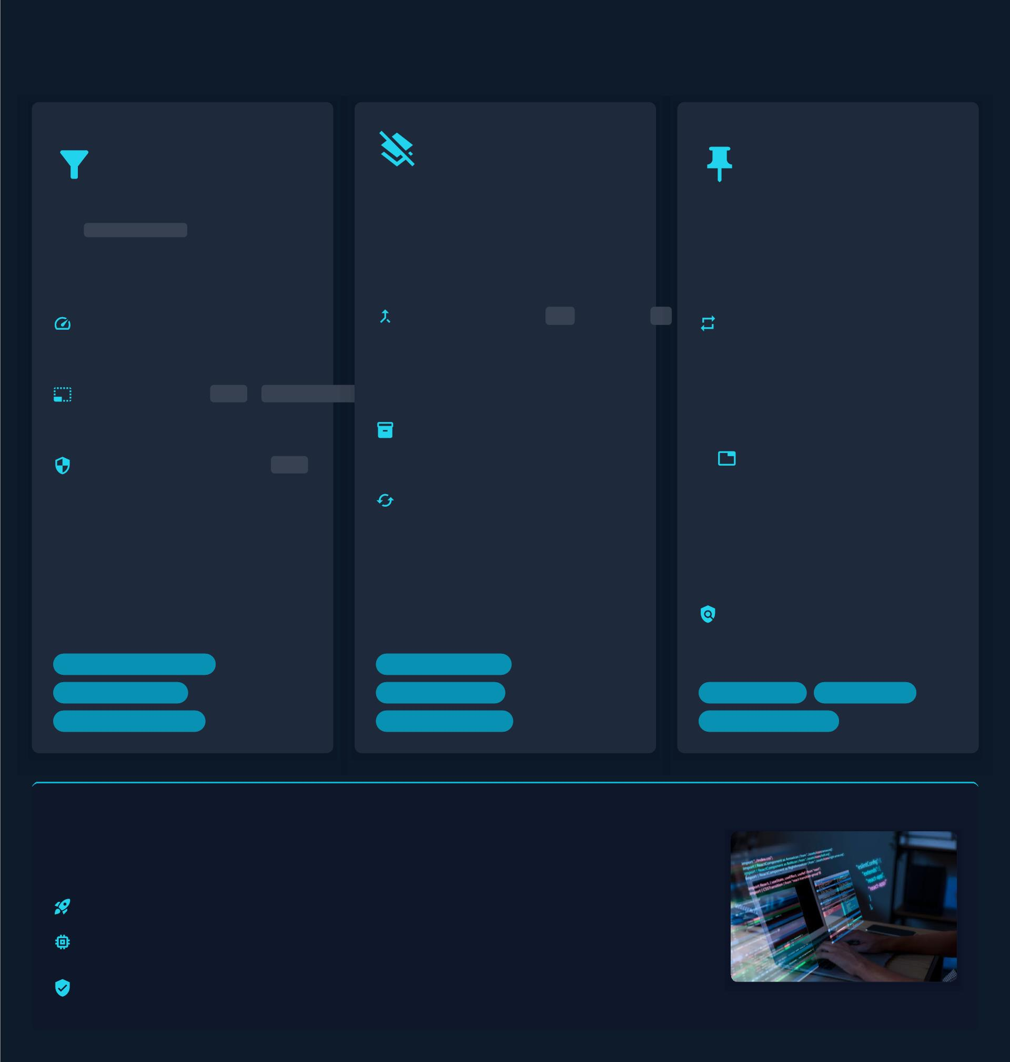
Dockerﬁle & Layer Management
Exclude
Unnecessary
Files
Streamline Build
Instructions
Ensure
Consistent
Builds
Each instruction in a Dockerﬁle
creates a new image layer.
Combining commands reduces
layers, optimizing image size and
cache eﬃciency.
The .dockerignore ﬁle prevents
speciﬁed ﬁles from being sent to
the Docker daemon, improving build
performance and security.
Always specify exact versions for
packages, libraries, and base
images to ensure deterministic and
reliable builds.
Faster Reduces the "build
Builds:context" size for quicker
daemon transfers.
Method:Chain
RUN instruction &&
using
Reproducibility:Guarantees
builds are
related
commands
consistent
into a
single
across all
SmallerEnsures .git or node_module
Images:irrelevant
environments
and time.
ﬁles like
ReducedFewer layers generally
Size:
result in a smaller ﬁnal
image footprint.
Stability:Prevents
EnhancedPrevents
Security: accidental
exposure of
.env .
unexpected
ImprovedMore eﬃcient layer
Caching: caching leads to
faster rebuilds.
breakage
from
sensitive ﬁles
like
Processed by PPT Studio
upstream
dependency
updates.
Security Simpliﬁes tracking
vulnerabilities tied to
Auditing:speciﬁc versions.
&
Build Context Reduction
Speed Optimization
Layer Consolidation
Optimized Caching
Footprint Reduction
Reproducibility
Build Stability
Security Enhancement
Security Traceability
Driving Eﬃciency and Reliability
Implementing these Dockerﬁle best practices is crucial for developing robust, maintainable,
and secure containerized applications. They collectively contribute to:
Faster Iteration Cycles:Quicker builds mean rapid testing and deployment.
Optimized Resource
Usage:
Smaller images reduce storage, bandwidth, and launch
times.
Enhanced Security
Posture:
Minimizing components and versions reduces vulnerability
exposure.
Sources: DevOpsCube, CloudNativeNow, Snyk
Notes:
Could not generate speaker notes: 429 You exceeded your current quota, please check your plan and billing details. For more information on this error, head to: https://ai.google.dev/gemini-api/docs/rate-limits. [violations {
quota_metric: "generativelanguage.googleapis.com/generate_content_free_tier_requests"
quota_id: "GenerateRequestsPerDayPerProjectPerModel-FreeTier"
quota_dimensions {
key: "model"
value: "gemini-1.5-flash"
}
quota_dimensions {
key: "location"
value: "global"
}
quota_value: 50
}
, links {
description: "Learn more about Gemini API quotas"
url: "https://ai.google.dev/gemini-api/docs/rate-limits"
}
, retry_delay {
seconds: 13
}
]

Slide 4
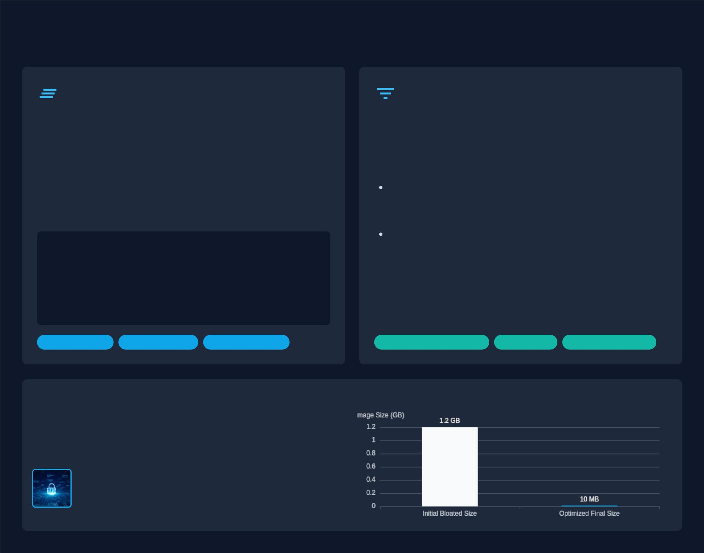
Ensuring Clean Builds
Eliminate Build Artifacts
Minimalist Toolset
During the build process, images accumulate temporary
ﬁles and package caches. If not removed, they bloat image
sizes and create potential security exposures.
Every non-essential tool, library, or package included in an
image contributes to its size and, more critically, expands
its potential attack surface.
Solution: Integrate cleanup commands into the same
`RUN` instruction that performs installations. This ensures
intermediate ﬁles are created and deleted within the same
layer.
Strategy:
Leverage Multi-Stage Builds to discard
development dependencies (compilers, SDKs, debuggers)
from the ﬁnal image.
Strict Dependency Review to ensure only
production-critical components are included in the ﬁnal
runtime.
# Debian/Ubuntu
RUN apt-get update && apt-get install -y --no-
install-recommends ... && rm -rf /var/lib/apt/lists/*
# Python
This proactive approach limits exposure to both known and
undiscovered security ﬂaws in superﬂuous software.
RUN pip install --no-cache-dir -r requirements.txt &&
rm -rf /tmp/*
Size Reduction
Layer Eﬃciency
Security Hygiene
Reduced Attack Surface
Lean Image
Performance Boost
Processed by PPT Studio
The Cumulative Impact: Size & Security
These practices cultivate a lean, secure, and eﬃcient container
environment. Managing build artifacts and curating the toolset achieves
signiﬁcant operational eﬃciencies and fortiﬁes security posture.
Fewer components mean fewer vulnerabilities to
exploit, enhancing overall system integrity.
Source: Docker Image BEST Practices - From 1.2GB to 10MB; Image: LEcmRiDR.jpg
Notes:
Could not generate speaker notes: 429 You exceeded your current quota, please check your plan and billing details. For more information on this error, head to: https://ai.google.dev/gemini-api/docs/rate-limits. [violations {
quota_metric: "generativelanguage.googleapis.com/generate_content_free_tier_requests"
quota_id: "GenerateRequestsPerDayPerProjectPerModel-FreeTier"
quota_dimensions {
key: "model"
value: "gemini-1.5-flash"
}
quota_dimensions {
key: "location"
value: "global"
}
quota_value: 50
}
, links {
description: "Learn more about Gemini API quotas"
url: "https://ai.google.dev/gemini-api/docs/rate-limits"
}
, retry_delay {
seconds: 13
}
]

Slide 5
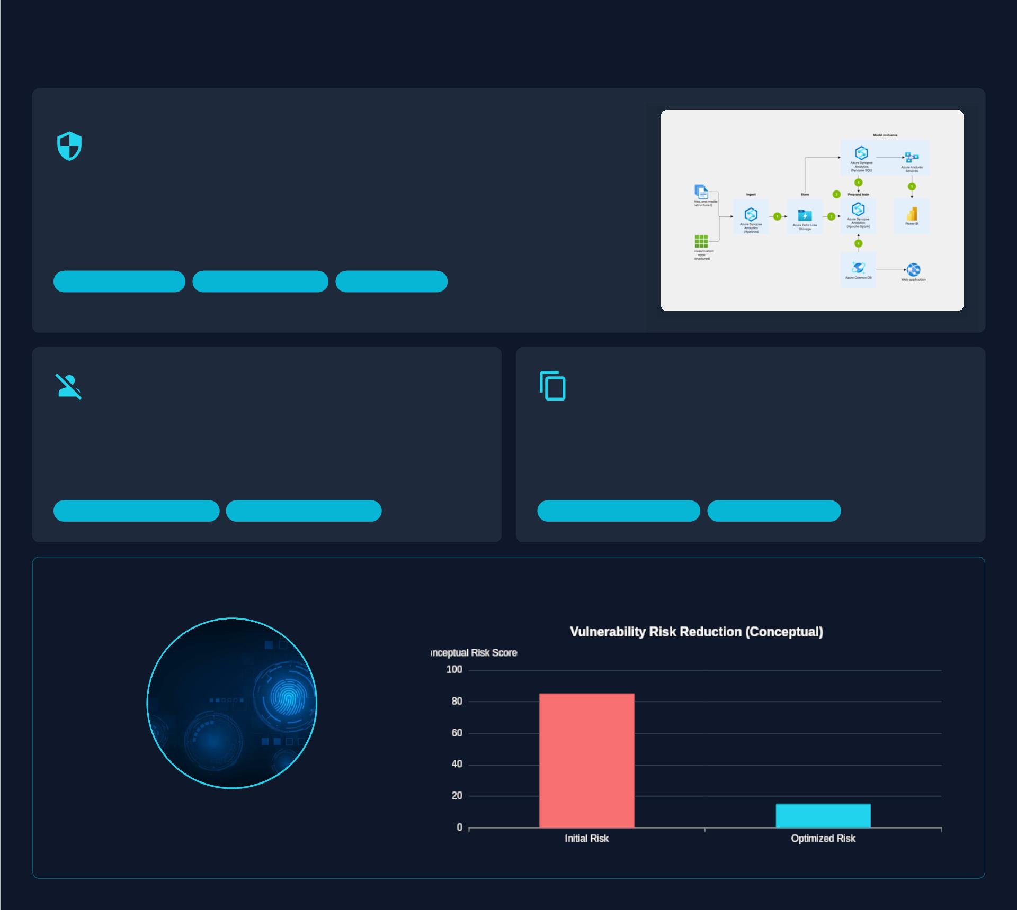
Security & Predictability
Integrate Proactive Vulnerability Scanning
Embedding security scanning into your CI/CD pipeline is a critical "shift-left" strategy. This
ensures images are automatically checked for known vulnerabilities (CVEs) at every build,
preventing insecure artifacts from reaching production.
Recommended Tools: Trivy, Docker Scout, Clair.
Shift-Left Security
Automated Vetting
Risk Mitigation
Enforce Non-Root Execution
Favor COPY for Predictability
Running containers as `root` is a security risk. If compromised, an
attacker gains elevated privileges. By creating and switching to a
non-root user, you apply the Principle of Least Privilege, limiting the
potential impact of a breach.
While `ADD` has extra features like remote URL fetching and tar
extraction, `COPY` is more predictable and secure. Its simplicity
prevents unexpected behaviors from malicious ﬁles or URLs,
making your Dockerﬁle easier to audit and debug.
Reduced Attack Surface
Privilege Containment
Improved Predictability
Enhanced Security
Processed by PPT Studio
Cumulative Security Impact
These practices reduce your attack surface and improve
reliability by combining proactive scanning, strict
privilege management, and predictable construction.
Notes:
Could not generate speaker notes: 429 You exceeded your current quota, please check your plan and billing details. For more information on this error, head to: https://ai.google.dev/gemini-api/docs/rate-limits. [violations {
quota_metric: "generativelanguage.googleapis.com/generate_content_free_tier_requests"
quota_id: "GenerateRequestsPerDayPerProjectPerModel-FreeTier"
quota_dimensions {
key: "model"
value: "gemini-1.5-flash"
}
quota_dimensions {
key: "location"
value: "global"
}
quota_value: 50
}
, links {
description: "Learn more about Gemini API quotas"
url: "https://ai.google.dev/gemini-api/docs/rate-limits"
}
, retry_delay {
seconds: 12
}
]

Slide 6
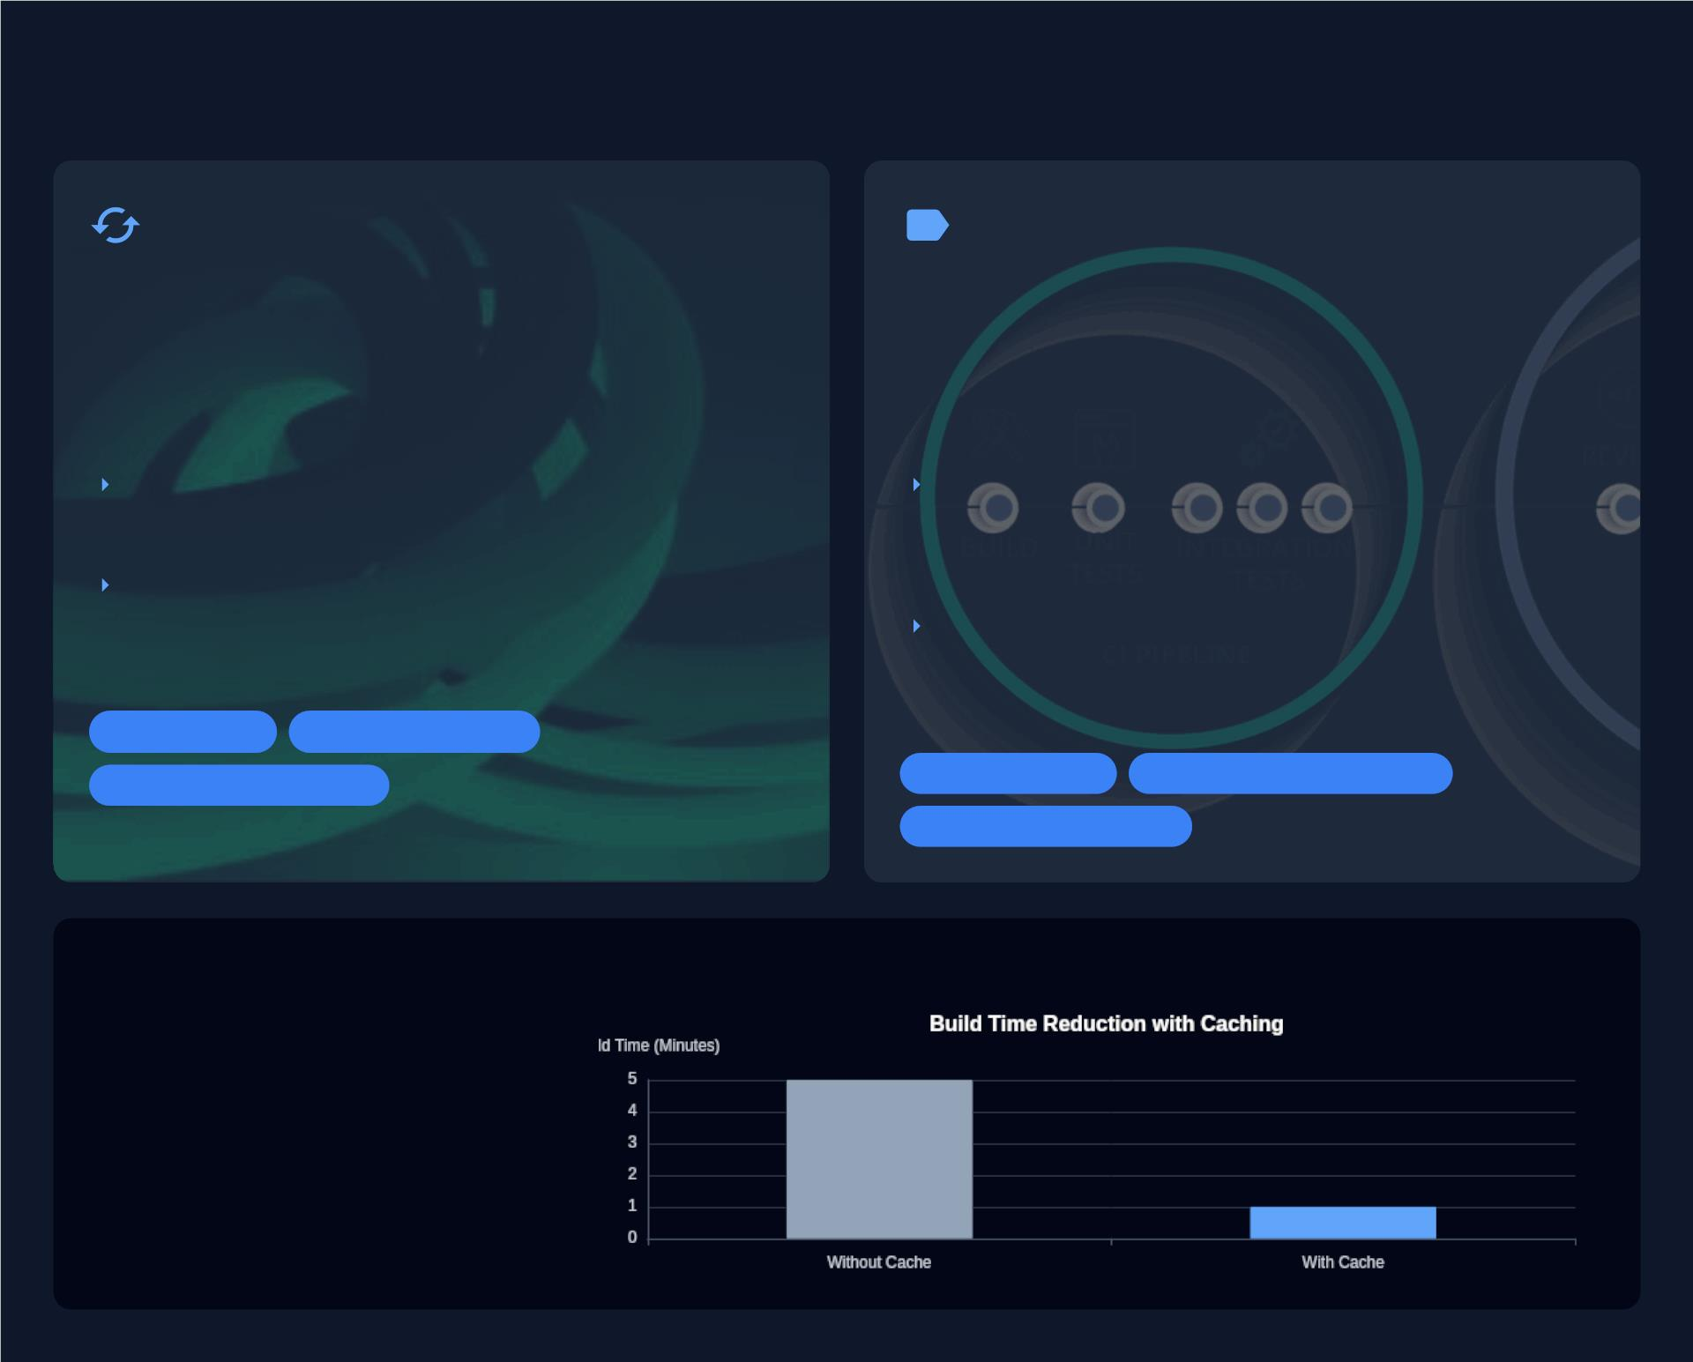
Eﬃciency & Maintainability
Build Cache Eﬃciently
Tag Images Clearly
Order Dockerﬁle commands from least to most
frequently changed to maximize cache reuse. This
dramatically reduces build times by reusing
previously built layers.
Use semantic and meaningful tags to manage and
version Docker images eﬀectively. Clear tagging is
crucial for reliable deployments and operational
clarity.
Place static dependencies like `apt-get` or `pip
install` before copying application code.
Use semantic versioning (e.g., `v1.2.3`) or
immutable Git SHAs for production releases to
ensure you deploy the exact build.
Changes to source code won't invalidate costly
dependency installation steps, speeding up
CI/CD pipelines.
Avoid using the mutable `latest` tag in
production, as it can lead to unintentional
deployments of untested code.
Faster Builds
CI/CD Acceleration
Resource Optimization
Version Control
Deployment Consistency
Enhanced Traceability
Processed by PPT Studio
Impact: Accelerated Development & Deployment
Applying caching strategies and
standardized tagging unlocks signiﬁcant
gains in productivity and reliability,
fostering a more eﬃcient and predictable
software delivery lifecycle.
Notes:
Could not generate speaker notes: 429 You exceeded your current quota, please check your plan and billing details. For more information on this error, head to: https://ai.google.dev/gemini-api/docs/rate-limits. [violations {
quota_metric: "generativelanguage.googleapis.com/generate_content_free_tier_requests"
quota_id: "GenerateRequestsPerDayPerProjectPerModel-FreeTier"
quota_dimensions {
key: "model"
value: "gemini-1.5-flash"
}
quota_dimensions {
key: "location"
value: "global"
}
quota_value: 50
}
, links {
description: "Learn more about Gemini API quotas"
url: "https://ai.google.dev/gemini-api/docs/rate-limits"
}
, retry_delay {
seconds: 11
}
]

Slide 7
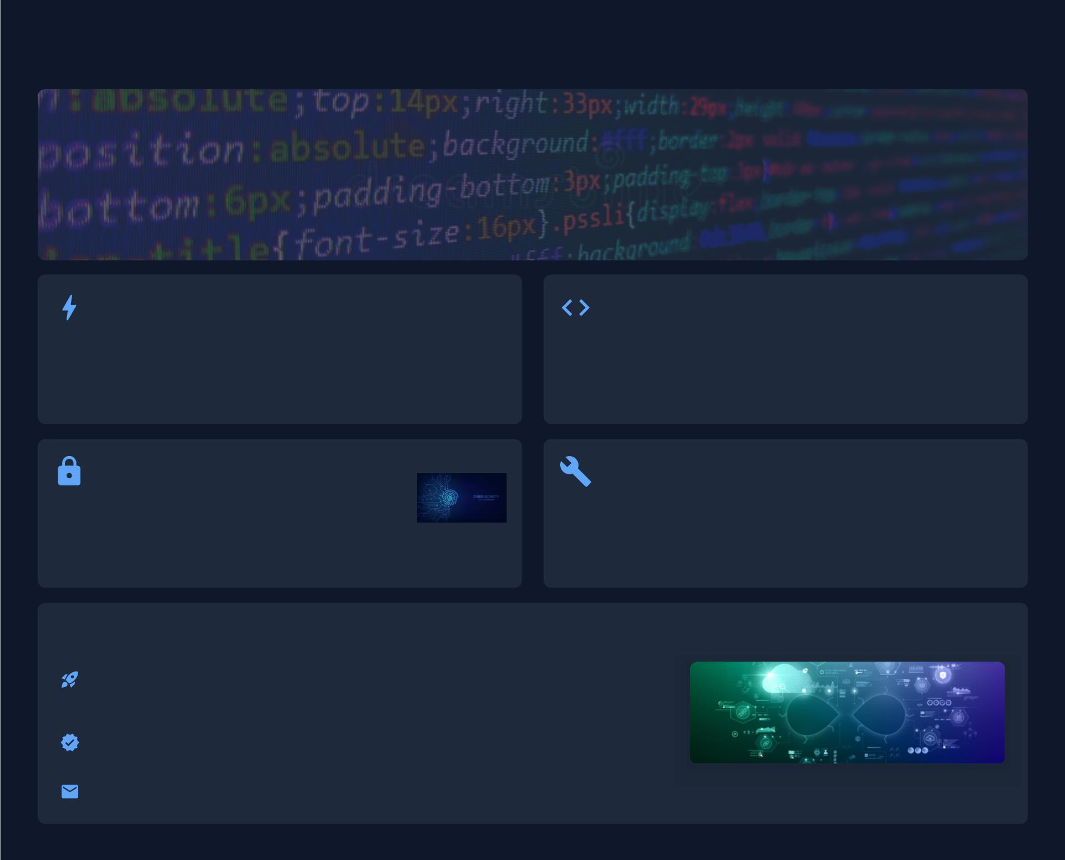
Key Takeaways & Next Steps
The Strategic Imperative of Docker Image Optimization
Throughout this session, we've explored how a meticulous approach to Docker image optimization transcends mere technical
best practices. It stands as a fundamental driver for enhancing the performance, security, and operational eﬃciency of
your containerized applications. Even small, targeted adjustments within your Dockerﬁles can yield signiﬁcant,
measurable improvements, transforming your development and deployment workﬂows.
Performance & Eﬃciency Gains
Ampliﬁed Impact of Small Changes
By embracing multi-stage builds, minimal base images, and
intelligent build cache use, you drastically reduce image sizes and
build times, leading to faster deployments and optimized resource
consumption.
The cumulative eﬀect of minor Dockerﬁle reﬁnements—like diligent
`.dockerignore` usage, meticulous layer minimization, and explicit
version pinning—results in substantial improvements in image
robustness and reliability.
Fortiﬁed Security Posture
Foundational Skills for Production
Proactive vulnerability scanning, enforcing non-root
execution, and precise dependency management are
critical for minimizing attack surfaces and ensuring
the integrity of your software supply chain.
The techniques discussed equip you with the foundational
knowledge to build cleaner, more secure, and highly eﬃcient Docker
images, setting the stage for truly production-ready container
deployments.
Processed by PPT Studio
Your Journey Towards Optimized Containers
Translate Knowledge into Practice: Begin implementing these best practices in
your projects. Experiment with multi-stage builds and integrate security scanning into
your CI/CD pipelines.
Apply these insights to streamline workﬂows and elevate the security and eﬃciency
of your container strategy.
For Further Discussion: x@y.com
Sources: Optimise Your Docker Images for Speed and Security, Smarter Containers, How to Reduce Docker Image Size, 10 Docker Security Best Practices, Building best practices
Notes:
Could not generate speaker notes: 429 You exceeded your current quota, please check your plan and billing details. For more information on this error, head to: https://ai.google.dev/gemini-api/docs/rate-limits. [violations {
quota_metric: "generativelanguage.googleapis.com/generate_content_free_tier_requests"
quota_id: "GenerateRequestsPerDayPerProjectPerModel-FreeTier"
quota_dimensions {
key: "model"
value: "gemini-1.5-flash"
}
quota_dimensions {
key: "location"
value: "global"
}
quota_value: 50
}
, links {
description: "Learn more about Gemini API quotas"
url: "https://ai.google.dev/gemini-api/docs/rate-limits"
}
, retry_delay {
seconds: 10
}
]

